Slide 1

Project And Employee Management
Submitted By:Namrata Sanger(17162101037)
Priya Jain(17162101049)

Slide 2

Module
Login
Dashboard

Slide 3
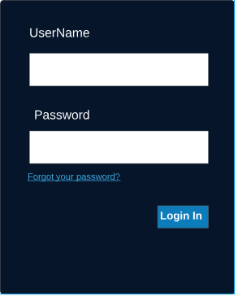
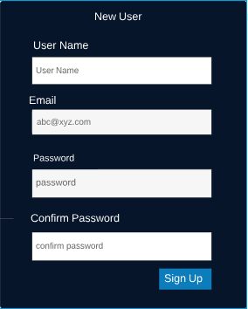
Login Page and Sign Up Page

Slide 4

Dashboard
Projects
Employees
Customers
Dealers
Settings

Slide 5
Project
Current Projects
Roadmap
Individual progress report
Edit(access)
Past Projects
No editing access
Automated email generation
Details

Slide 6

Employee
Task
Attendance
Settings
Dealers and Customers
All personal details

Slide 7
Database
Employee table
Customer table
Project tables
Dealers table
Over all project progress table
Account details

Slide 8
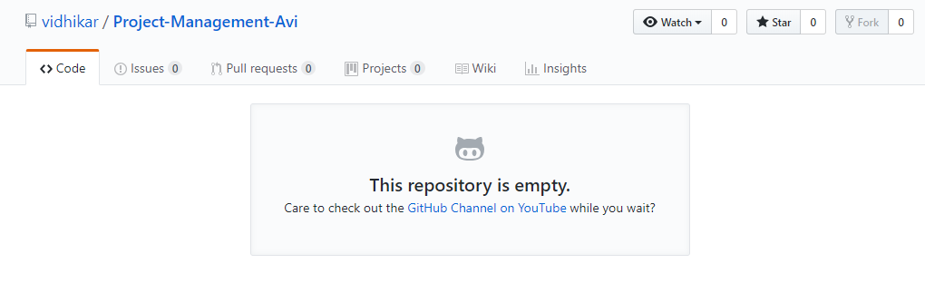
Github repository

Slide 9
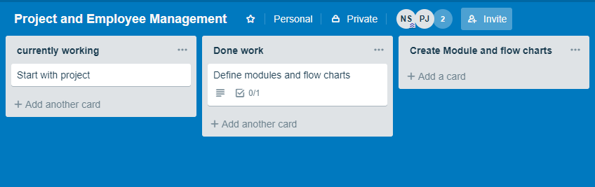
Trello activities

Slide 10
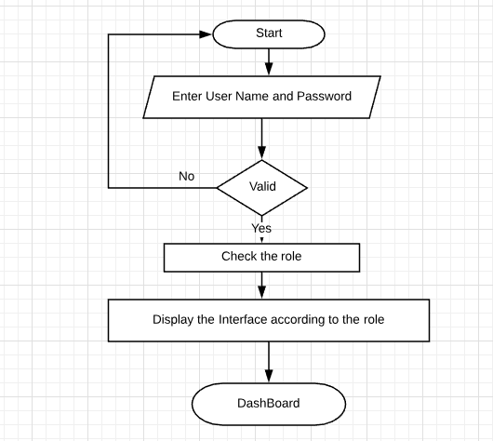
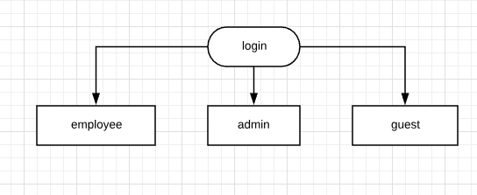

Slide 11
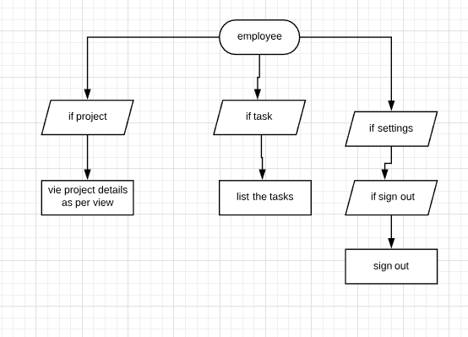
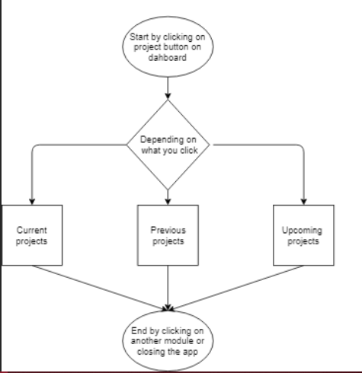

Slide 12
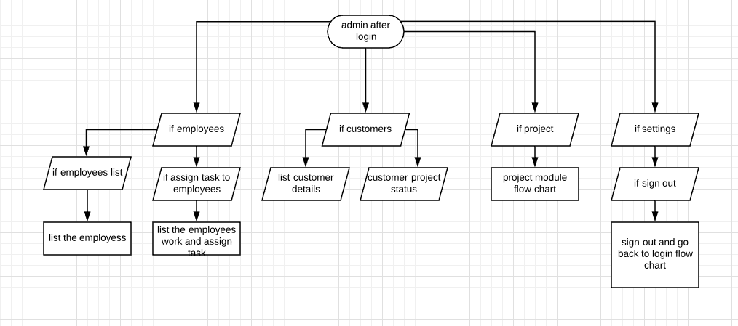

Slide 13
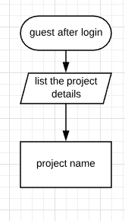

Slide 14
THANK YOU

